Slide 1

Exploration Opportunities
Offshore Atlantic Morocco

Slide 2
Presentation Summary
Introduction
Geological framework
Petroleum systems
Examples of play concepts
Conclusions

Slide 3
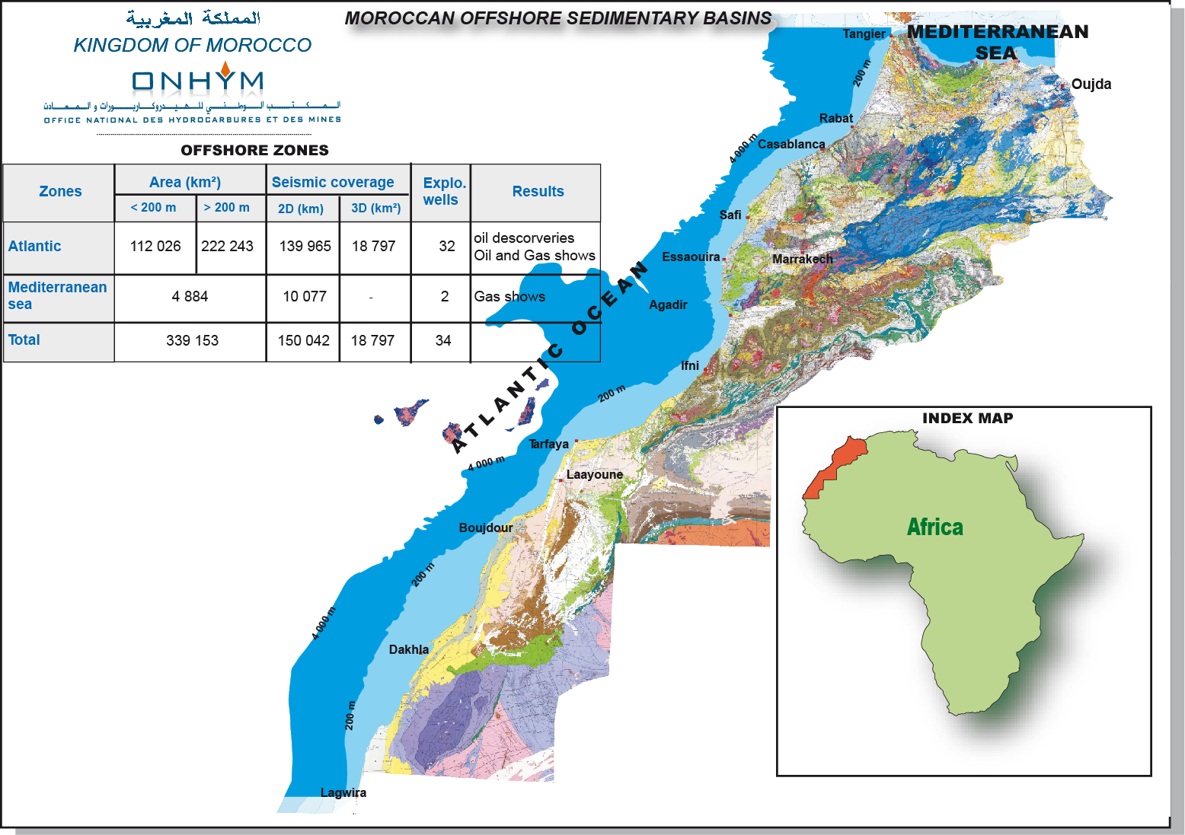
Atlantic Offshore
Moroccan offshore sedimentary basins

Slide 4
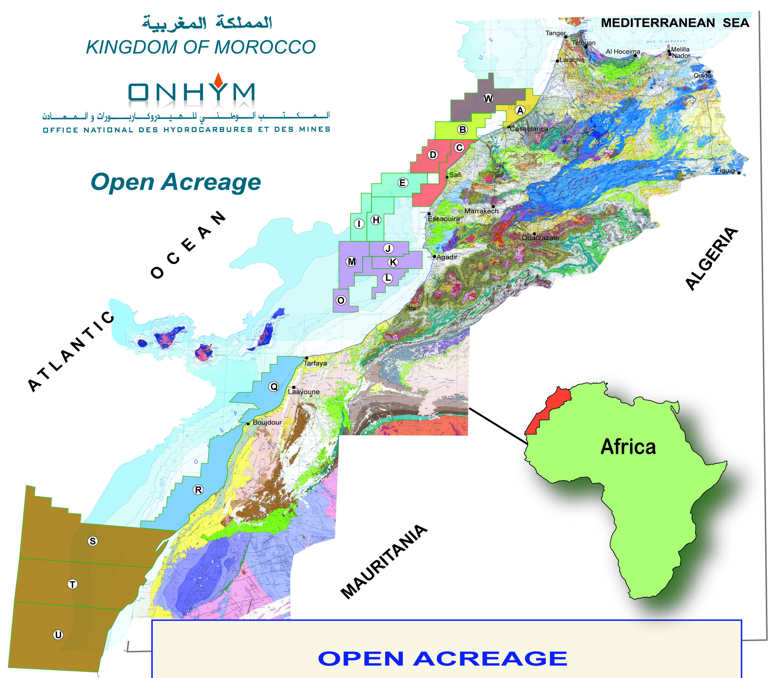
Atlantic Offshore
25 Blocks originally
(7 converted into 52 permits)
18 Open Blocks offshore
200 Prospects & Leads

Slide 5
Atlantic Offshore
REGIONAL GEOLOGICAL FRAMEWORK

Slide 6
Atlantic Offshore
Chronostratigraphic Chart
AGM
Souss
-
2
-
1
AGM
Stage
W
-
1
E
Tectonic Events
Pleistocene
High Atlas
Inversion &
Anti Atlas
uplift
Pliocene
U. Miocene
M. Miocene
L. Miocene
Oligocene
Eocene
Souss delta
Paleocene
Input coarse clastics
Via Souss trough
Salt Tectonics
Upper Cretaceous
Turonian
Cenom. Albian
Relatively rapid
thermal subsidence
Passive Margin
Lower
Cretaceous
Tan-Tan delta
Sourced from Tan-Tan
delta
Mid / Late
Jurassic
Carbonate Platform
E. Jurassic
Syn-rift
Tectonic
subsidence
Triassic
Late Permian
…
…
Paleozoic
Pre-rift
Pre-Cambrian

Slide 7
Atlantic Offshore
PETROLEUM SYSTEMS

Slide 8
Atlantic Offshore
SOURCE ROCKS DISTRIBUTION AND RICHNESS
BTS-1
Marcan-1
AGM-1
AGM-2
AMB-1
RAK-1
DSDP 370
DSDP 545
DSDP 547
DSDP369
Alisio 15
Spansah 51
Miocene
Oligocene
Tertiary
Eocene
TOC 4-7%
TOC 1-5%
TOC 1-2%
Paleocene
TOC 2-6%
Maas
TOC 1-3%
Maastrichtian - Santonian
Camp
TOC 2-3%
Log Response
Sant
Coniacian - Turonian
Con
TOC 19%
Tur
TOC 2%
TOC 3-4%
TOC 6-15%
Cen
TOC 2%
TOC 1-2%
TOC 1-2%
Cenomanian - Albian
Alb
TOC 2-4%
TOC 1-2%
TOC 1%
TOC 1%
TOC 1-5%
TOC 2-4%
TOC 1-2%
TOC 3.8%
TOC 2-4%
Apt
TOC 1-2%
TOC 1%
Bar
Haut
Aptian - Neocomian
Val
Ber
U Jur
TOC 1%
Jurassic
M Jur
TOC 9%
L Jur
Triassic
Rich source rock
Tan Tan-1 Jurassic source rock 2.5
MO-6, -7 Early Cretaceous 1-3%

Slide 9
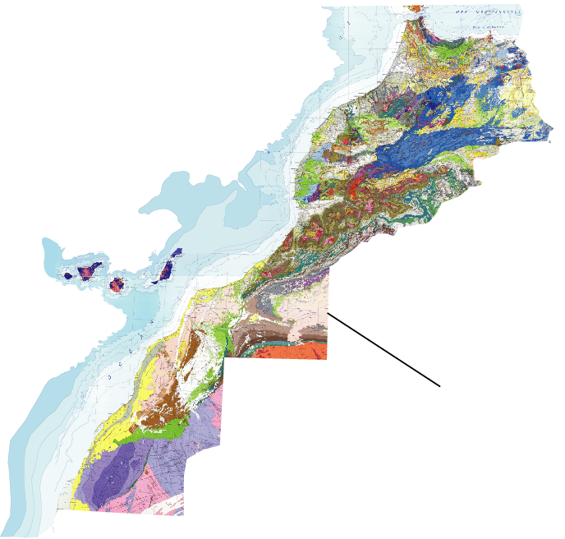
Atlantic Offshore
SOURCE ROCKS: Lower Jurassic
EVIDENCE IN MOROCCO
SIDI FILI
RIF
ACCUMULATIONS AND SEEPS
Sidi Fili oil field
Rif and Middle Atlas oil seeps
GTE-1 oil shows
MO-8 Light oil
WELLS AND OUTCROPS
Sidi Fili up to 5.5% TOC & 19.6 mg/g S2
DSDP-547 up to 8.9 %TOC & 48.5 mg/g S2
TanTan-1 well up to 2.5 % TOC; 800 HI
Middle Atlas to 3.4% TOC & 19.6 mg/g S2
Fuerteventura black shale
DSDP 547
Middle Atlas
GTE
TANTAN-1
Fuerteventura
MO-8
Wells
Outcrops

Slide 10
Atlantic Offshore
SOURCE ROCKS: Upper Jurassic
EVIDENCE IN MOROCCO
ESSAOUIRA BASIN
  Sidi Rhalem oil field
  TKM well: Oxfordian shale
  up to 4.3 % TOC
OFFSHORE WELLS
  DSDP-547 up to 1.9 %TOC
  IFNI-1 up to 3.36 % TOC
Fuerteventura Island
  80m Oxfordian black shale
DSDP 547
Sidi Rhalem
TKM-201
IFNI-1
Fuerteventura
Wells
Outcrops

Slide 11
Atlantic Offshore
SOURCE ROCKS: Aptian-Albian
  Locally developed thin“bituminous shales” onshore in the Rif and western High Atlas
  BTS-1: tested minor trace of oil; TOC 2 – 4% and a HI of 280-340.
  MarCan-1: TOC to 2.4% & S₂ to 8.9 mg/g 82% type II and 18% type III
  DSDP 544: TOC to 4.5%
  DSDP 370/416: TOC to 6.2% & S₂ to 31 mg/g
  DSDP-369 up to 3%.
  40 m organic rich black shale crops out in Fuerteventura.
RIF
DSDP 544
DSDP 416
BTS-1
ATLAS
MarCan
Fuerteventura
DSDP 369
Wells
Outcrops

Slide 12
Atlantic Offshore
SOURCE ROCKS: Cenomano - Turonian
Tarfaya oil shale quarry, the source rock interval is 50 m thick, with a TOC of 2-19%.
AGM-2 3.5% TOC, 574 HI.
Amber-1 well 26 m thick section. Turonian interval wih 12.5% to 15.9% TOC.
RAK-1 well encountered organic rich laminea
AMB-1
RAK-1
AGM-2
TARFAYA
DSDP 369
Water well
Wells
Outcrops

Slide 13
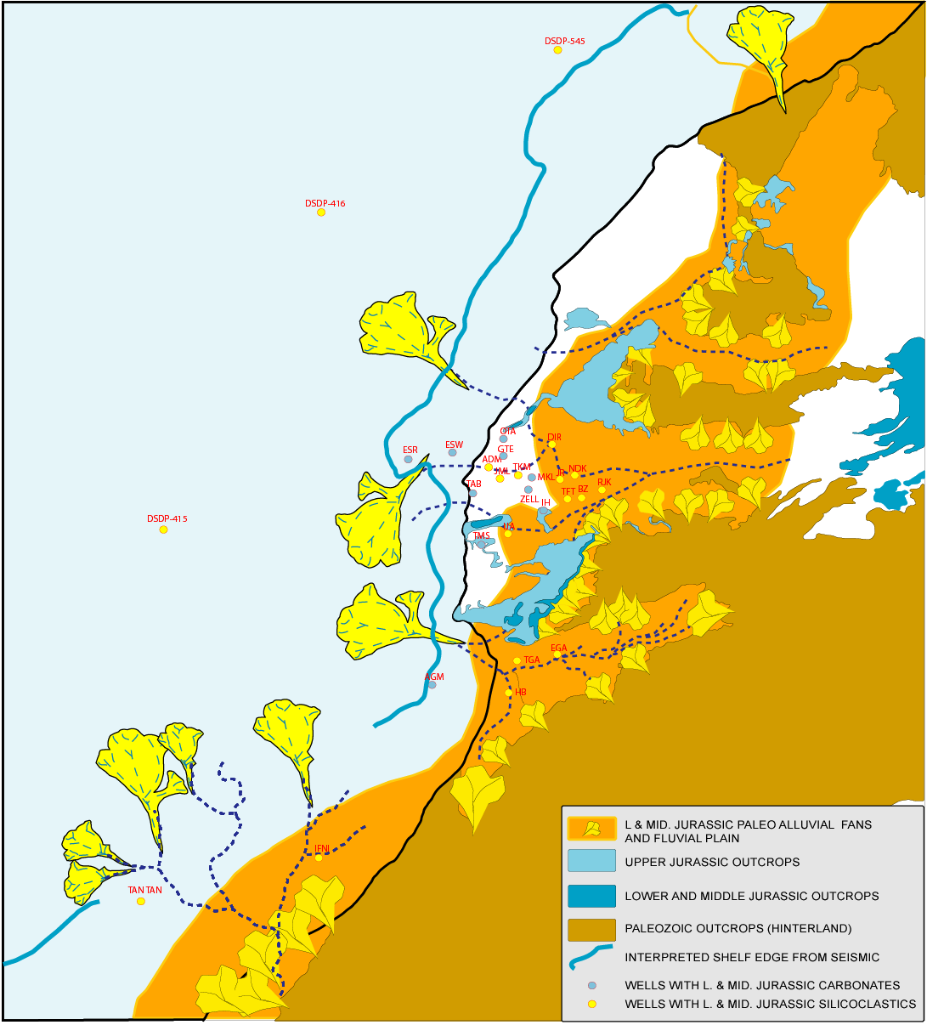
Atlantic Offshore
LOWER & MIDDLE JURASSIC RESERVOIR ROCKS DEVELOPMENT
Paleogeographic map of the northern Moroccan
Atlantic margin during L& M Jurassic
    MAIN FINDINGS
  Widespread developed alluvial and fluvial systems close to the Hercynian massifs.
  Sandstones bypassed the carbonate platform at several locations and developed turbidite complexes.
  Two major and permanent entries of sandstones into the basin.
  Development of deltas

Slide 14
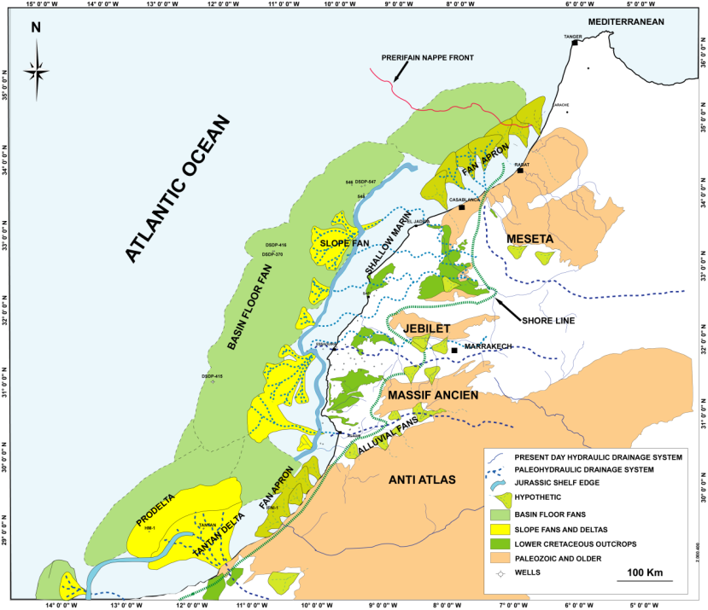
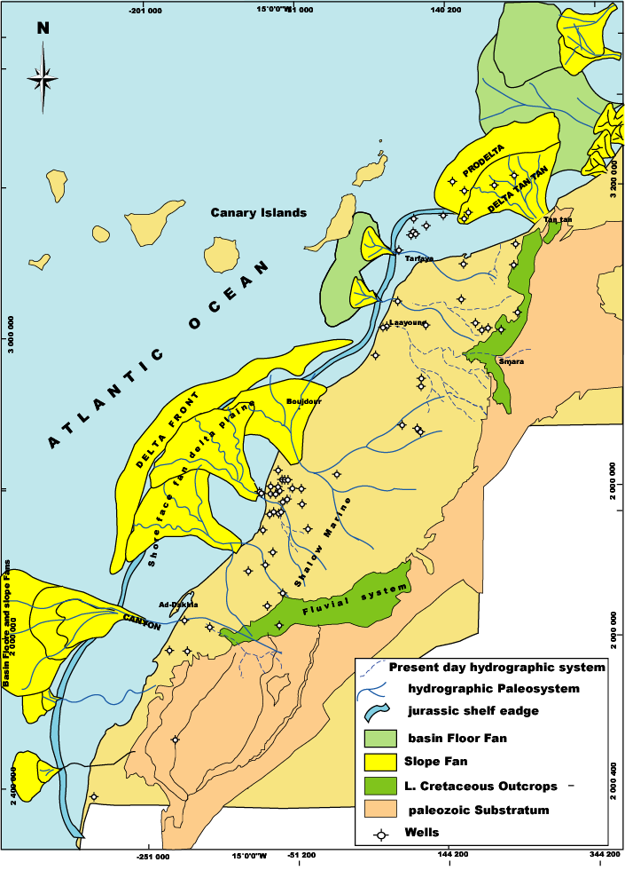
Atlantic Offshore
LOWER CRETACEOUS RESERVOIR ROCKS DEVELOPMENT
MAIN FINDINGS
Fluvio-deltaic deposits in the
onshore
Development of fan apron and
deltas on the shelf (TanTan &
Boujdour)
Development of turbidites on the
slope and the basin (Seismic)
Distal fans present at DSDP 370/416
and Fuerteventura Island outcrop
Provenance from Reguibat, Anti-
Atlas, Massif Ancien and Meseta
(Paleozoic metasediments and
granites)
Lower Cretaceous Paleogeographic map

Slide 15
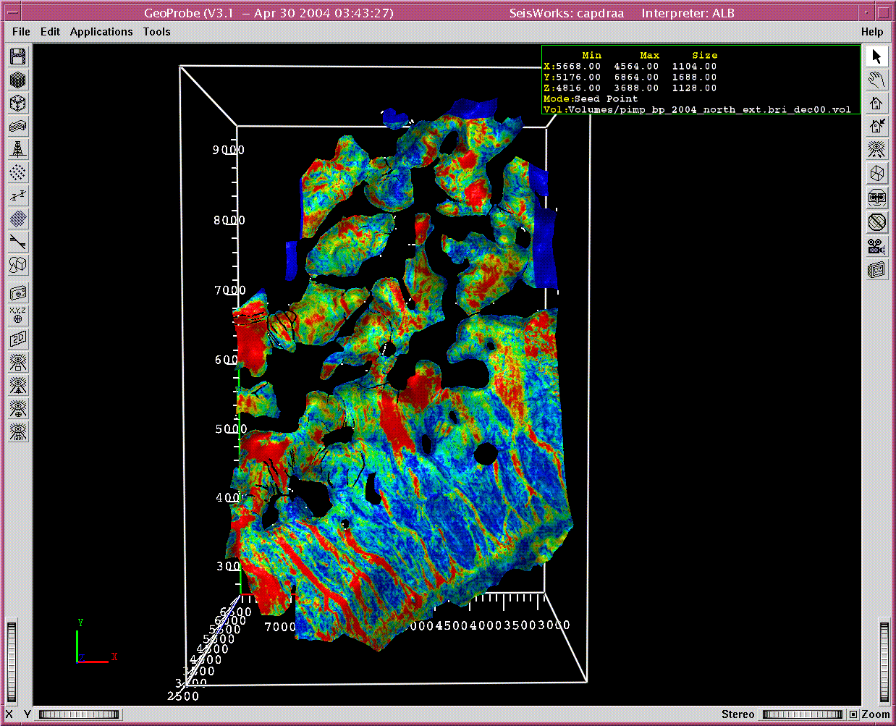
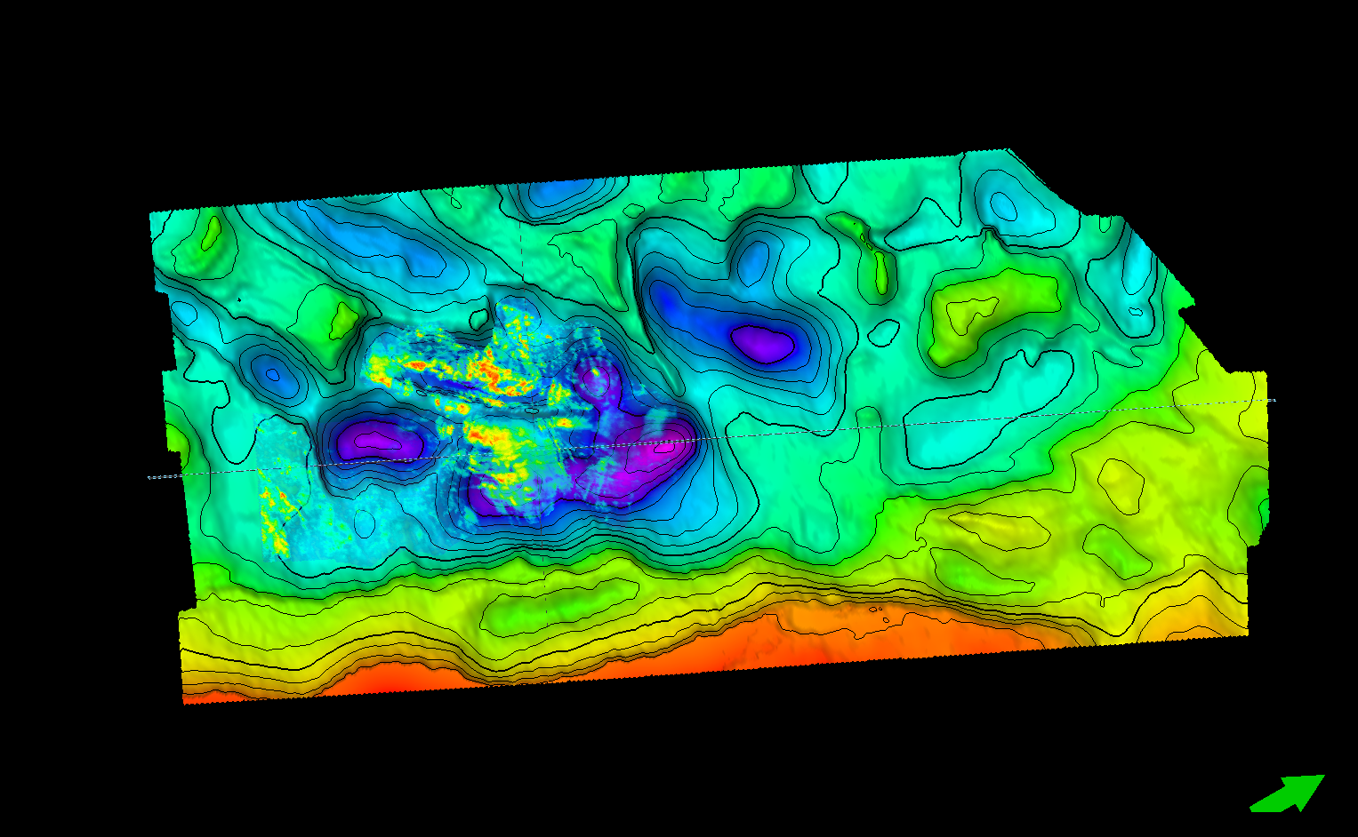
Atlantic Offshore
LOWER CRETACEOUS RESERVOIR ROCKS DEVELOPMENT
RMS Amplitude
Corroboration from seismic amplitudes of development of the Lower Cretaceous reservoir rocks as channel fills and ponded sands in intra-salt diapirs mini basins
Spectral decomposition

Slide 16
Atlantic Offshore
PLAY CONCEPTS

Slide 17
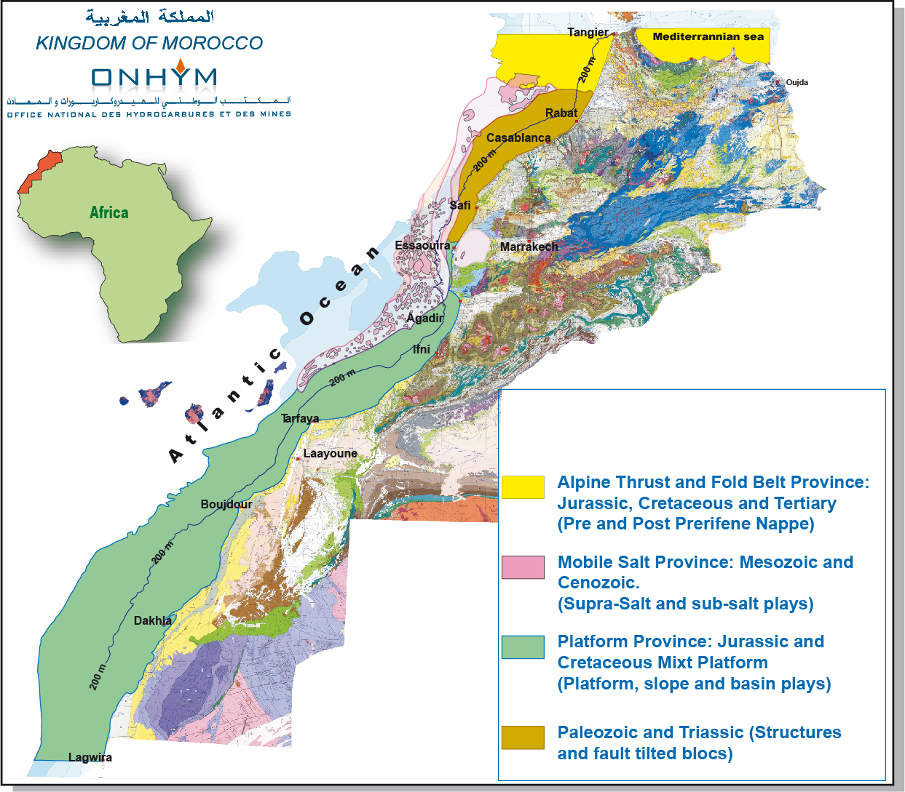
Atlantic Offshore
MAIN OFFSHORE PROVINCES

Slide 18
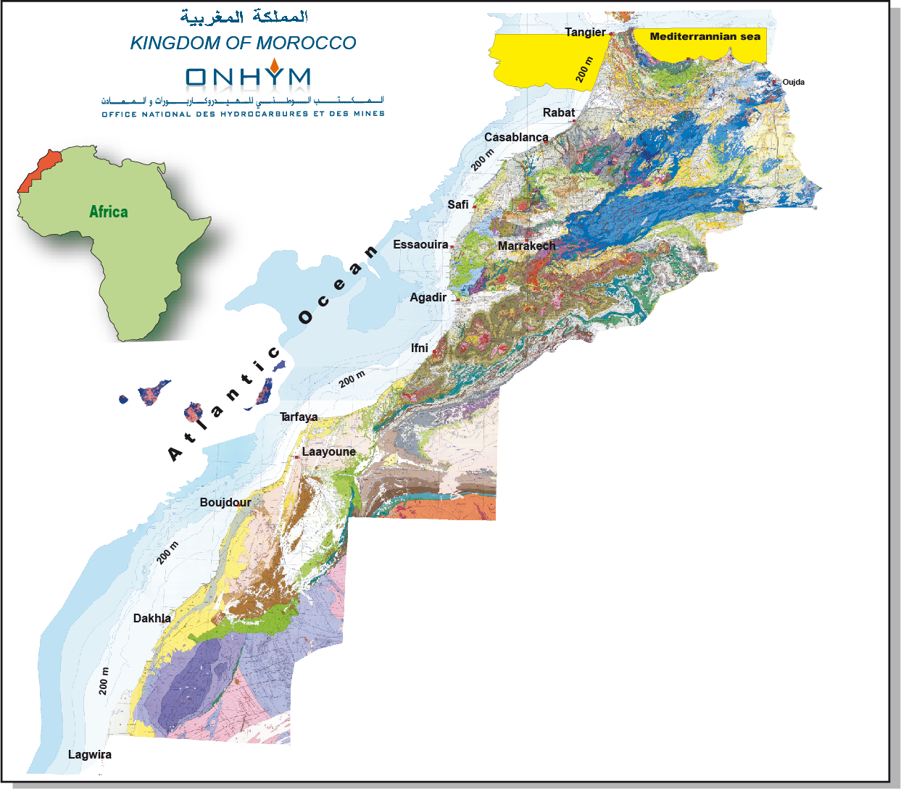
Atlantic Offshore
ALPINE FOLD AND THRUST BELT
Post-Nappe Sequence
  Tertiary series (SR, RR and Seal)
  Biogenic gas (Bright spots) “Repsol”
  Stratigraphic and Structural traps
Pre-Nappe Sequence
  Jurassic, Cretaceous & Tertiary series
  Structural trapping mechanism
  Mesozoic Source beds
  Oil and gas

Slide 19
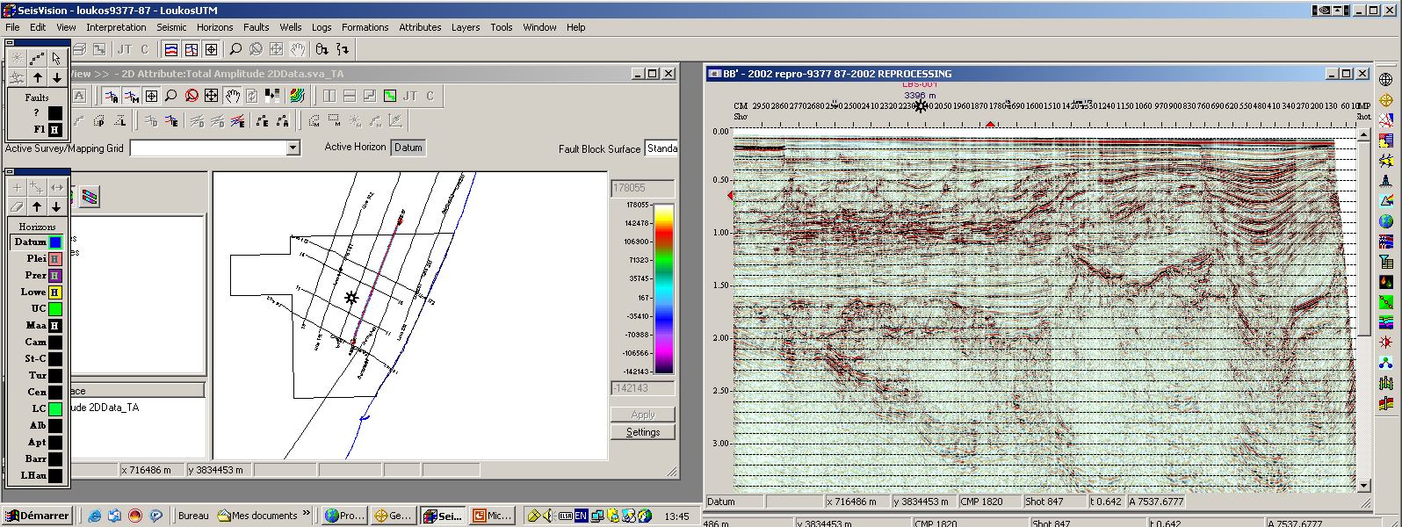
Atlantic Offshore
S
N
Post-Nappe
Prerifain Nappe (Accretionary wedge)
Pre-Nappe
Post-Nappe: Tertiary turbiditic sandstones
Stratigraphic and structural traps (Bright spots)
Pre-Nappe: Tertiary sandstones and Cretaceous carbonates and sandstones
Structural traps (Alpine tectonic event)

Slide 20
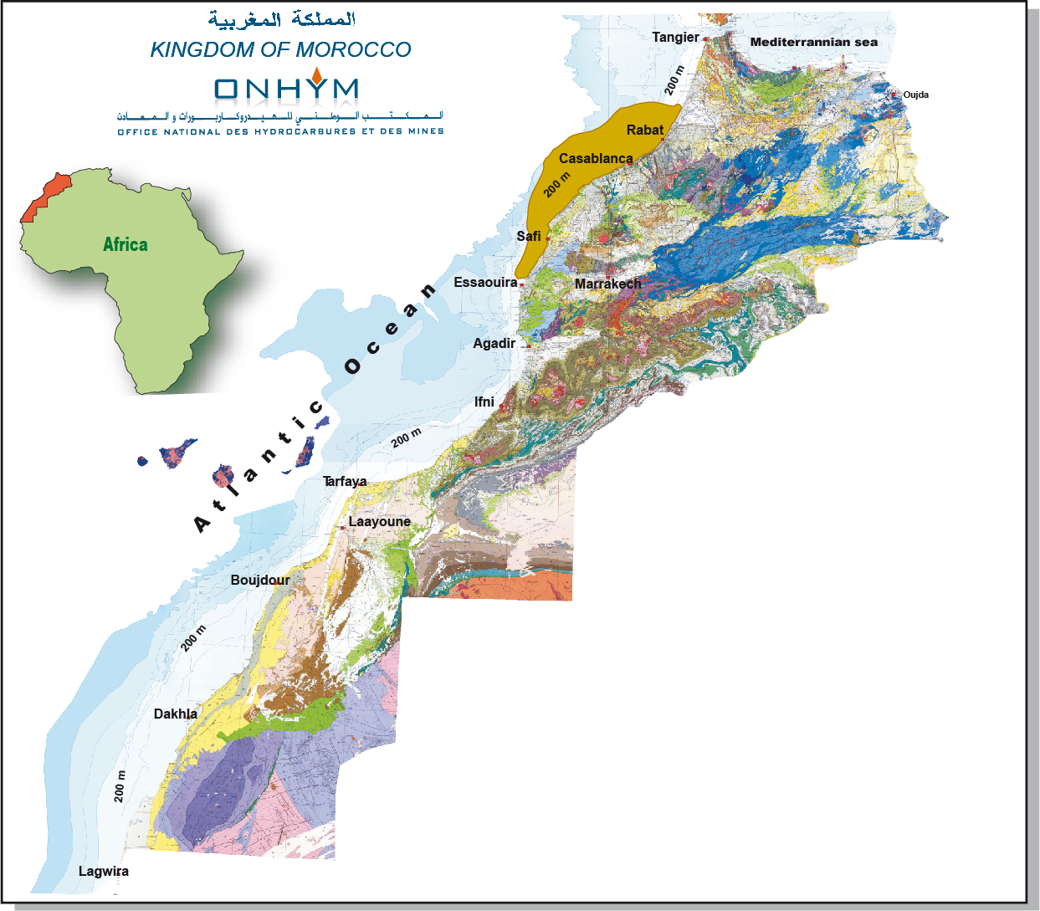
Atlantic Offshore
PRE-RIFT AND SYN-RIFT PROVINCE
Pre-Rift Sequence
  Paleozoic Sandstones and Carbonates
  Silurian-Devonian Source Rocks
  Structural & Stratigraphic traps
Syn-Rift Sequence
  Triassic & Lower Lias Sandstones
  Oil and gas (Meskala field)
  Fault tilted blocs
  Silurian-Devonian Source Rocks

Slide 21
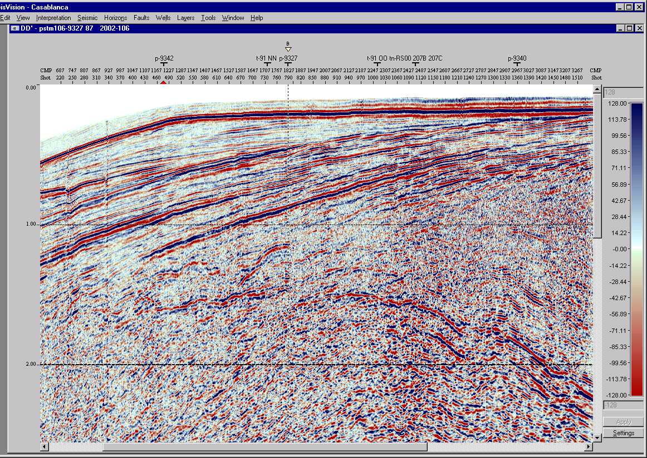
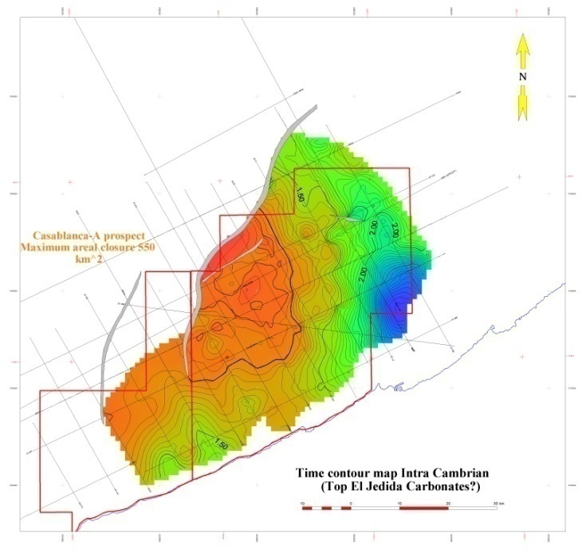
Atlantic Offshore
NW
SE
  PALEOZOIC PLAY
  Structural Traps (170-310 km²)
  Reservoir: Cambro-Ordovician Quartzitic sandstones
  Source rocks: Silurian-Lower Devonian
  Seal: Triassic salt and Jurassic anhydrite

Slide 22
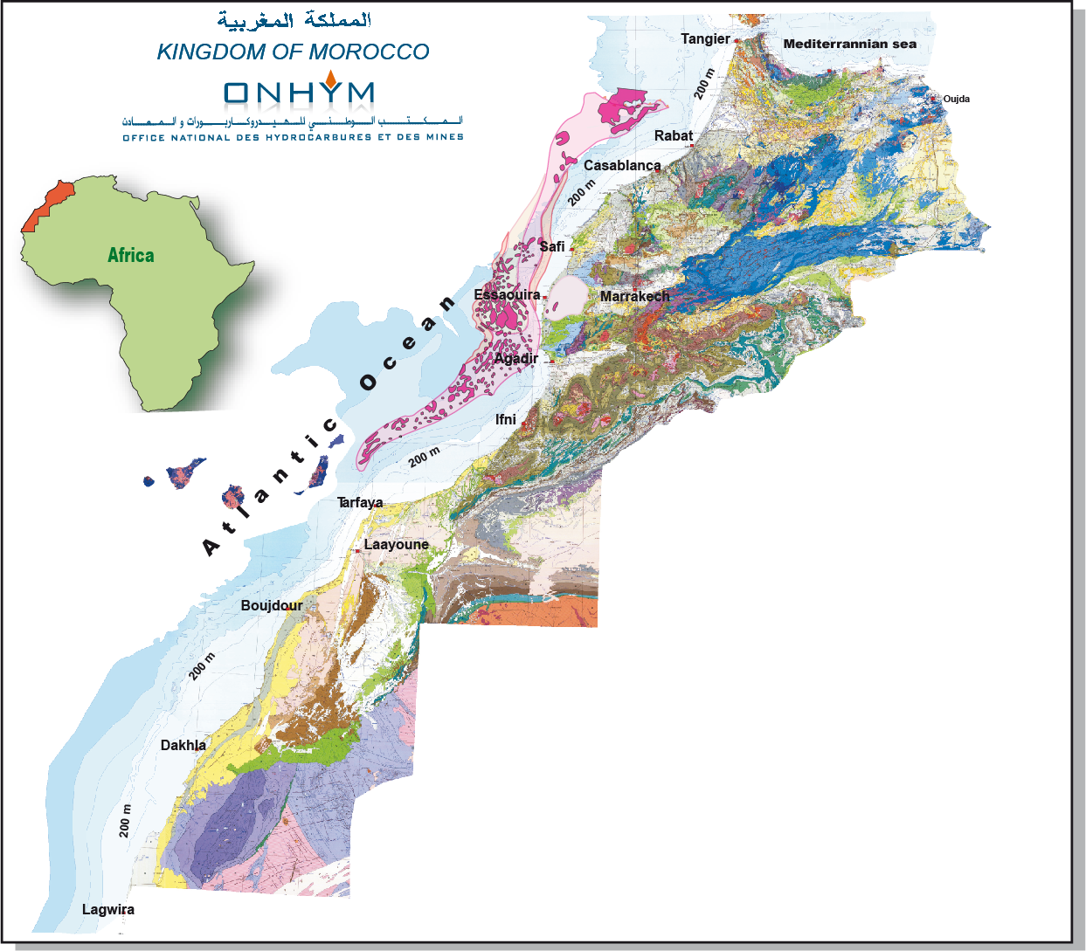
Atlantic Offshore
SALT PROVINCE
Supra-Salt Sequence
  Jurassic, Cretaceous and Tertiary
  Turbiditic sandstones
  Oil & gas
  Salt induced Structural & Stratigraphic
  traps
  Resources: 11 MMBO to 1 140 MMBO
Sub-Salt Sequence
  Jurassic and Cretaceous turbiditic
  sandstones
  Structural traps
  Oil and gas

Slide 23
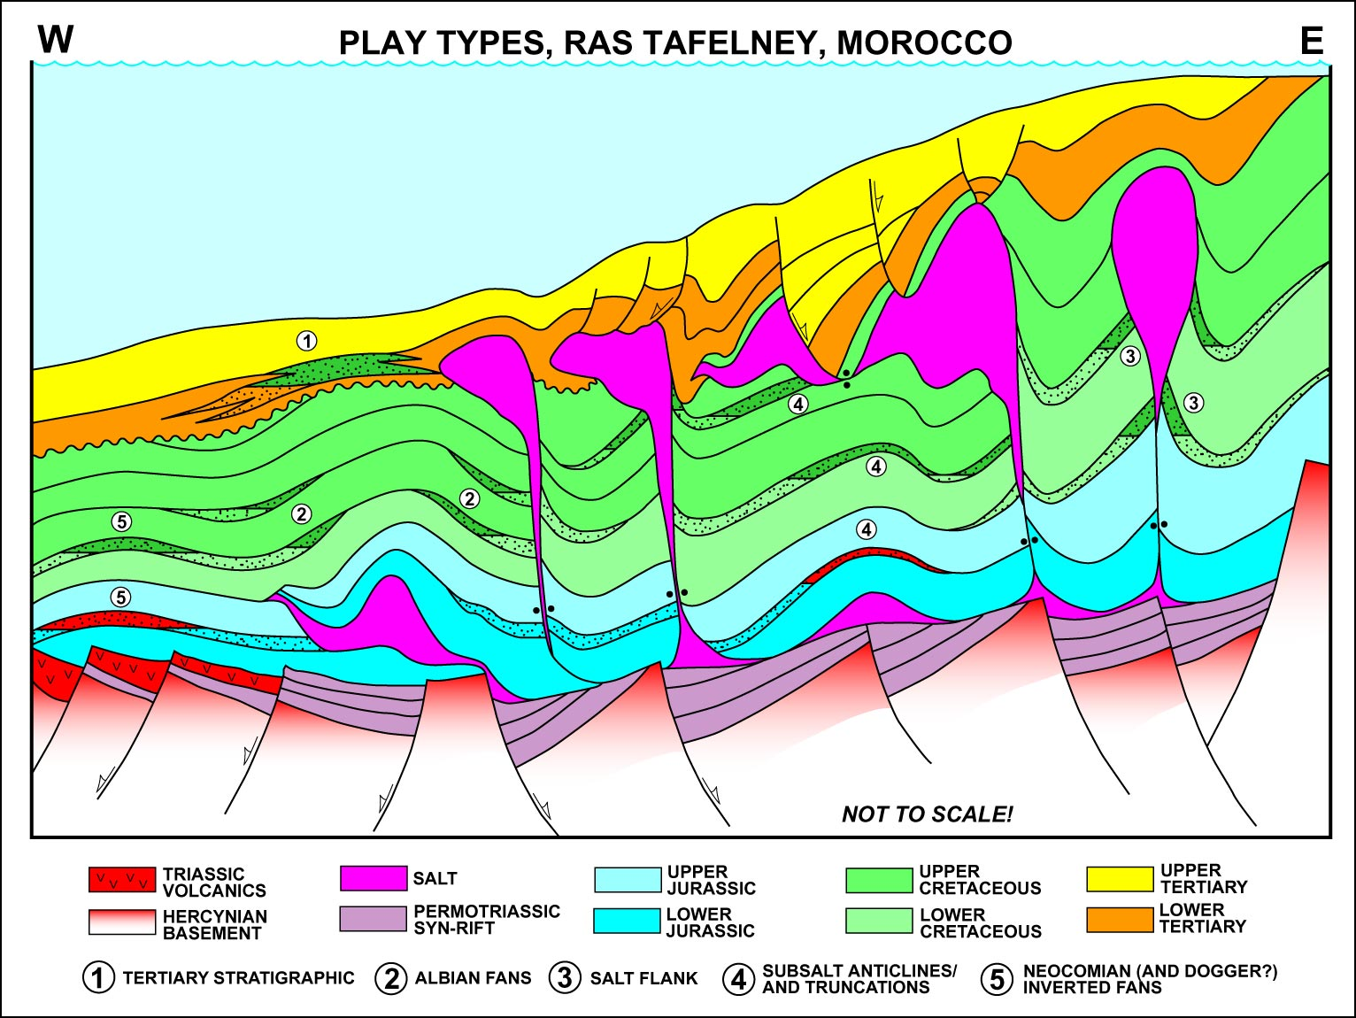
Atlantic Offshore
Salt Province Play Concept Types
T
TT
SS
SD
After Vanco
SD: Salt Diapir play (entirely covered by 2D)
SS: SubSalt plays (entirely covered by2D)
TT: Toe Thrust Play (entirely covered by3D)
Tertiary stratigraphic plays (entirely covered by3D)
Jurassic and Neocomian basin floor fan (entirely covered by3D)

Slide 24
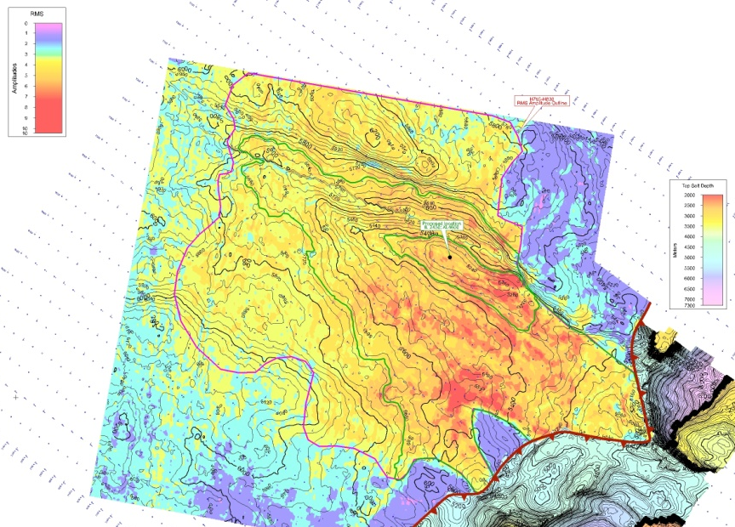
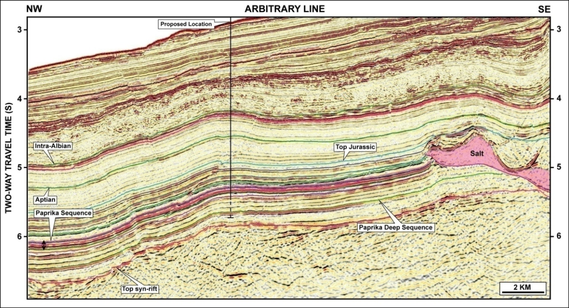
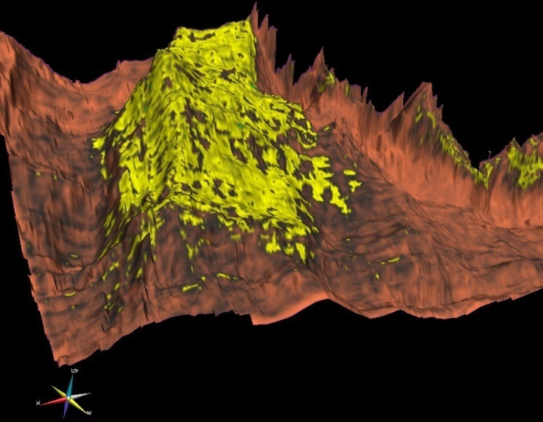
Atlantic Offshore
4 way closure
RMS Amplitude
Prospect Characteristics
Lower & Upper Jurassic SR (Up to 9 & 4,5 % TOC )
Upper Lias /Dogger and Neocomian Basin floor
fan sandstones
Resources:
4-Way closure
    Mean = 3.2 TCF
    4-Way closure + RMS Amplitude outline
    Mean = 7.3 TCF
3 D view Amplitude extraction
sandstones distribution

Slide 25
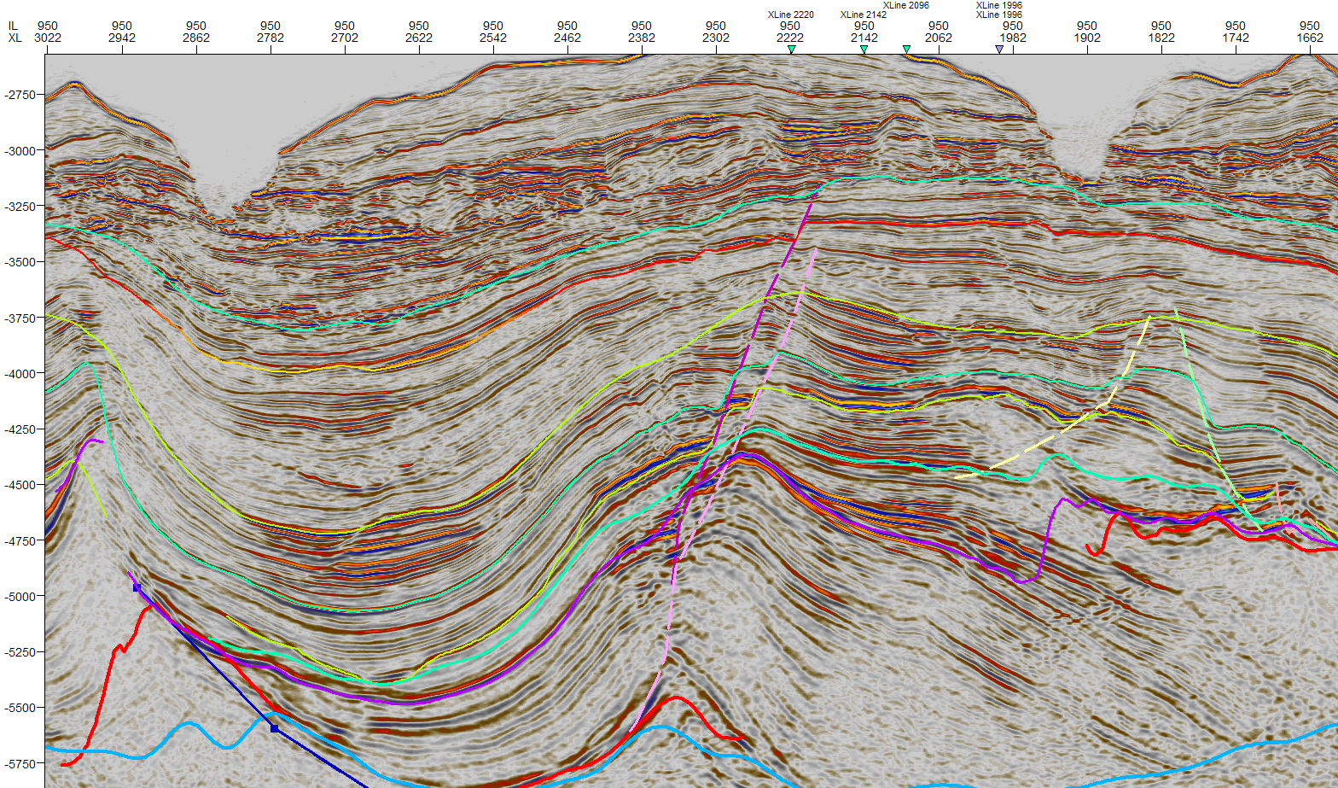
Atlantic Offshore
Combined Structural-Stratigraphic Salt Related Prospect
Up. Cretaceous
Low. Cretaceous
Time structure map at top L. Cretaceous
Jurassic
  Prospect Characteristics
  Jurassic and Lower Cretaceous turbidites covalent of the distal turbidites in DSDP and
  fluvial sandstones at the Present day shore line
  Source beds: Lower Jurassic, Oxfordian and Aptian-Albian
  Clear 4-way dip closure at several levels
  Vertical Migration through faults
  Resources:450 MMbbls (Mean)

Slide 26
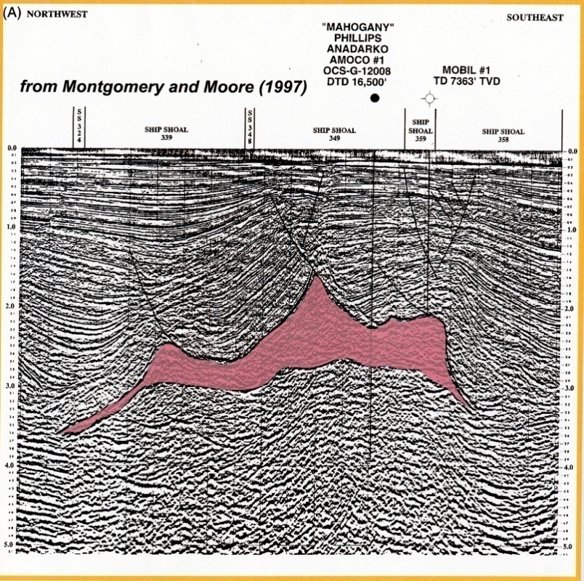
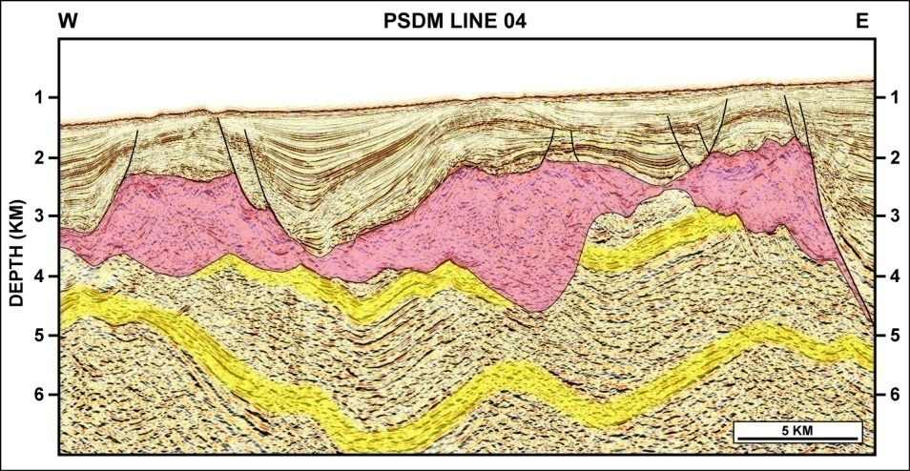
Atlantic Offshore
Sub-Salt Analogs
Mahogany Field Gulf of Mexico (USA)
Reserves are in excess of 100 MMBOE
in three slope fan sandstone bodies of Middle Miocene age.
Moroccan Atlantic Offshore
Neocomian sandstones target
Not well assessed. Needs 3D seismic coverage and test

Slide 27
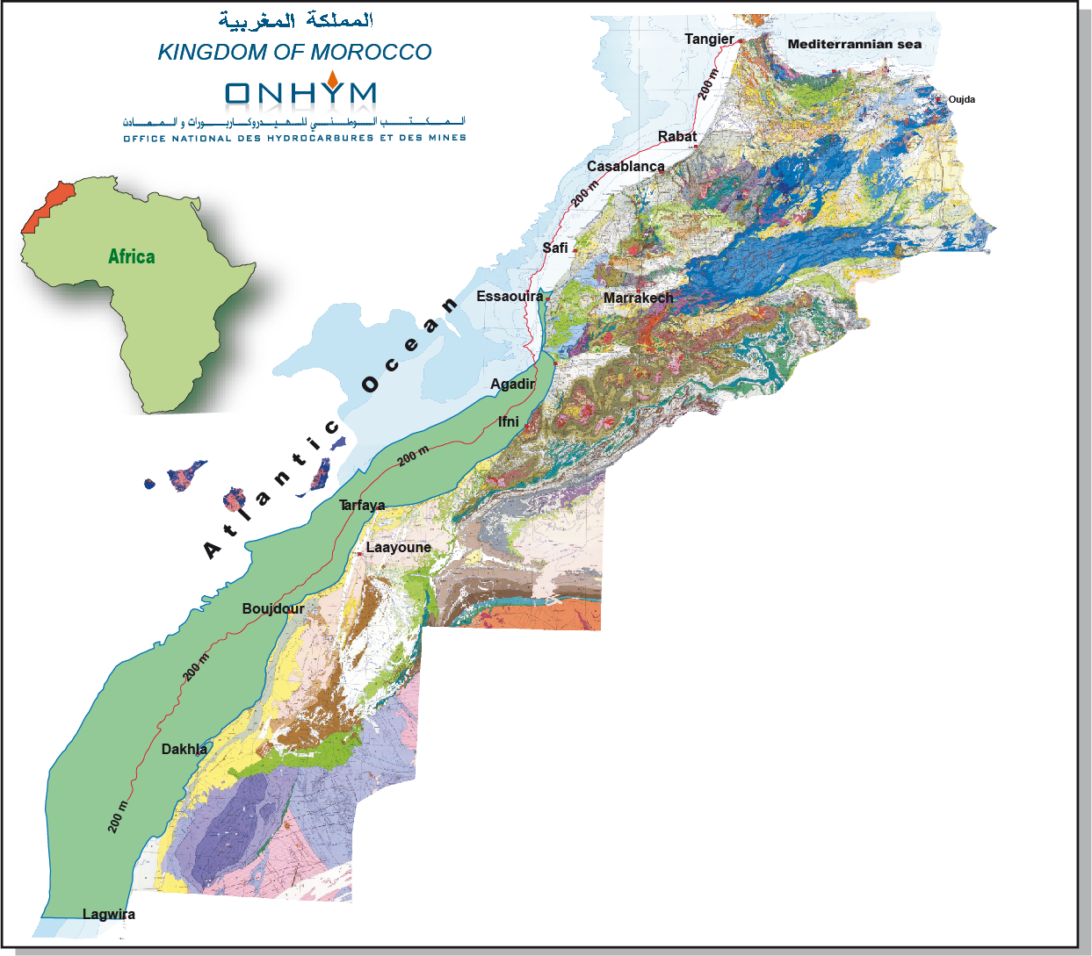
Atlantic Offshore
PLATFORM & DEEP SEA PROVINCE
Platform Area
  Jurassic and Cretaceous Sequences
  Oil & gas
  Salt induced Structural & Stratigraphic traps
  Shallow marine sandstones and carbonates
Deep Sea area
  Neocomian, Coniacian and Tertiary
  Structural and stratigraphic Traps
  Mesozoic Source beds
  Oil and gas

Slide 28
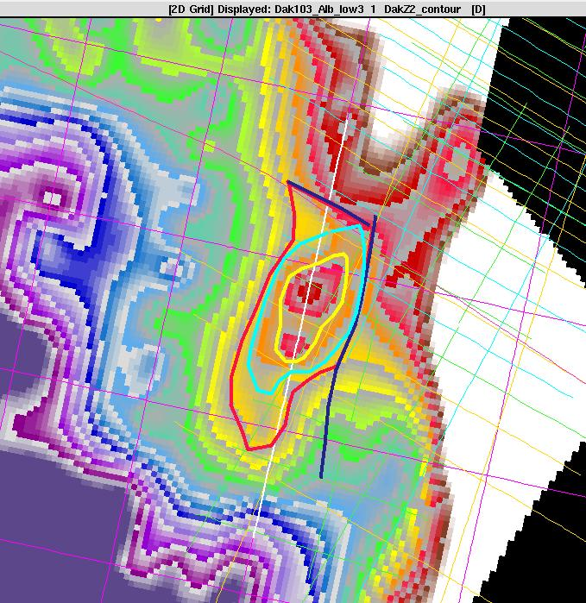
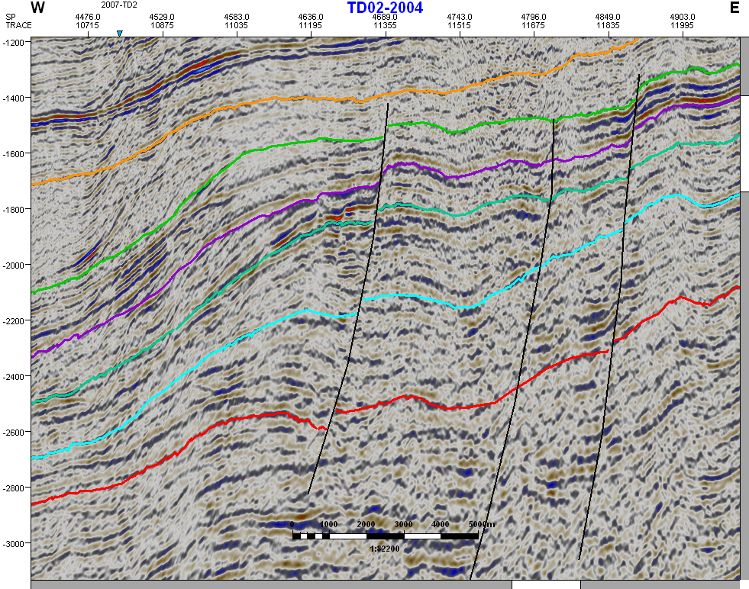
Depth Structure Albian turbidite –
Atlantic Offshore
Coniacian
Base Tertiary
Albian
Aptian
Cenomano-Turonian
  Prospect Characteristics
  Lower Cretaceous (Albian) and Upper Cretaceous (Coniacian) sandstone turbidites
  Source beds: Aptian-Albian and Cenomanian-Turonian
  4-way dip roll over structures
  Vertical Migration through faults or lateral
  Resources:450 mmbbls (Mean)

Slide 29
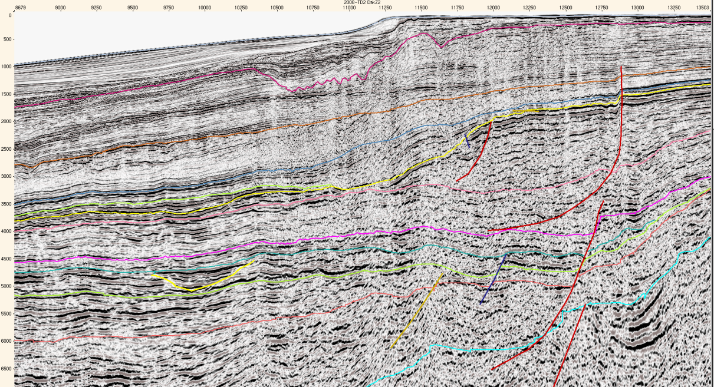
Atlantic Offshore
ESE
Base Oligocene
2000m
Base Tertiairy
Top Santonian
Base Coniacian
4000m
Mid Albian
L. Albian
Upper Aptian
6000m
10 km
Top Jurassic
  Prospect Characteristics
  Lower Cretaceous (Albian) and Upper Cretaceous (Coniacian) sandstone turbidites
  Source beds: Aptian-Albian and Cenomanian-Turonian
  4-way dip roll over structures and basin floor fan
  Vertical Migration through faults or lateral
  Resources: 2 Bbbls (Mean)

Slide 30
Atlantic Offshore
Achievements:
Seismic Acquisitions :
140 000 km of 2D
19 000 km² 3D
Identification of over 200 prospects and leads;
Resources = 11 – 1 140 MMbbls and up to 11 TCF of Gas;
34 wells drilled ;
Assessment of the petroleum systems (in progress at ONHYM).
What could next:
Resumption of intensive exploration of the untested plays, both in the
inboard and the outboard areas of the salt province, with new ideas;
Reevaluation and upgrade of the previously identified prospects and
leads to go ahead for drilling;
Visit to ONHYM office for detailed presentations, discussions and data
room consultation.

Slide 31
Thank you

